Slide 1
Pituitary gland pathology

Slide 2

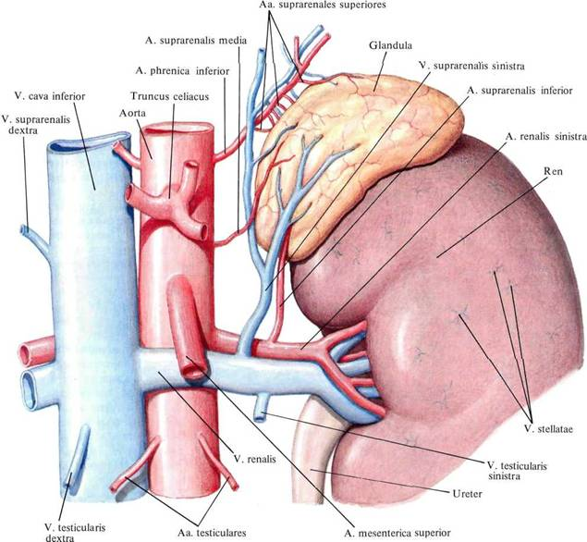
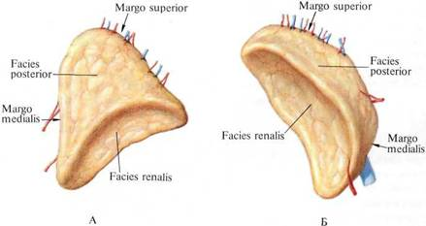
Plan
Hypopituitarism
Prolactinoma

Slide 3

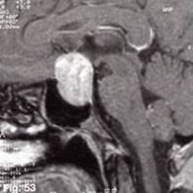
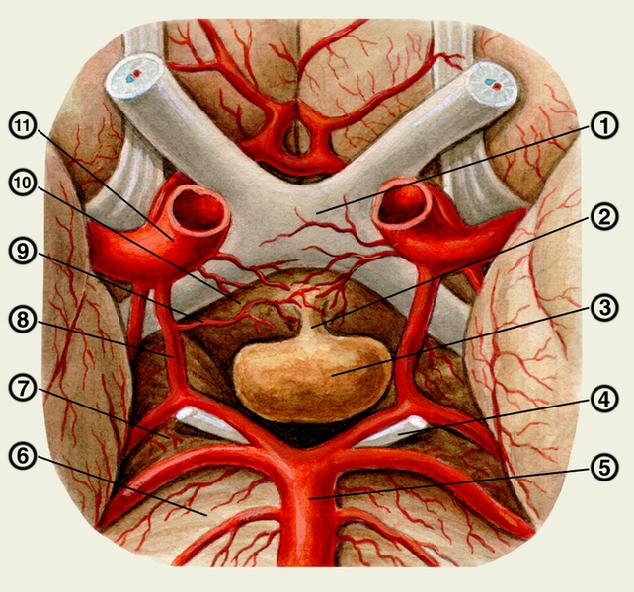
Tumors of the adenohypophysis
Hormone INactive 23%
Hormone active
Prolactinoma 27%
ACTH-secreting 15%
Mixed 12%
LH or FSH-secreting 8%
TSH-secreting 1%
occurs about Remaining 14% ----- Metastases

Slide 4
Tumors of the adenohypophysis
General cerebral symptoms
Clinic
Symptoms of hormonal activity
Symptoms of crushing structures
СиSymptoms of hormonal loss

Slide 5
Опу Symptoms of hormonal loss
TSH-secreting adenoma
TSH-secreting adenomas are rare.
Usually these are large, extending beyond the Turkish saddle adenomas. They can compress the optic junction and cause visual impairment. These tumors can cause destruction of surrounding cells and their failure. TSH-secreting adenomas function autonomously.

Slide 6
Tumors of the adenohypophysis
Gonadotropin-Secreting Adenoma
Tumors of the adenohypophysis
Gonadotropin-Secreting Adenoma
A gonadotropin-secreting adenoma is usually a macroadenoma. The gonadotropins secreted by it in excess contain mainly a biologically inactive alpha subunit, while the beta subunit, biologically active, is contained in a reduced amount. Therefore, most patients have manifestations of hypogonadism.

Slide 7
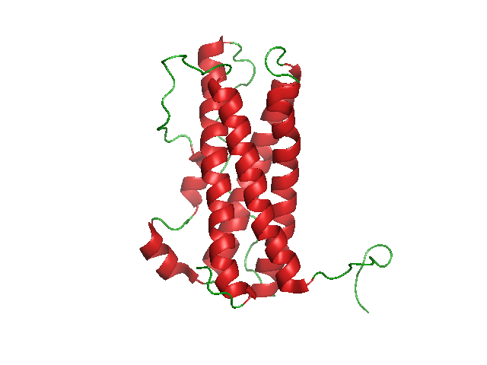
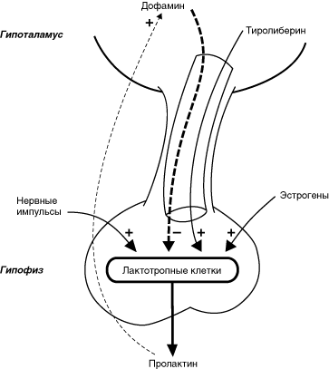
prolactin
The hormone of the anterior pituitary gland, peptide 199 a-k, is synthesized in the pituitary gland (similar to STH)
Stimulants TRG
Estrogens
Irritation nipple
Dopamine inhibitors

Slide 8
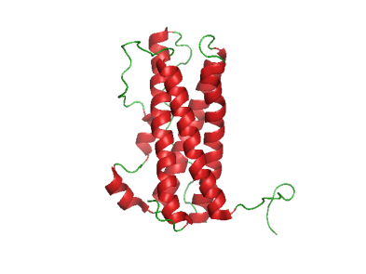
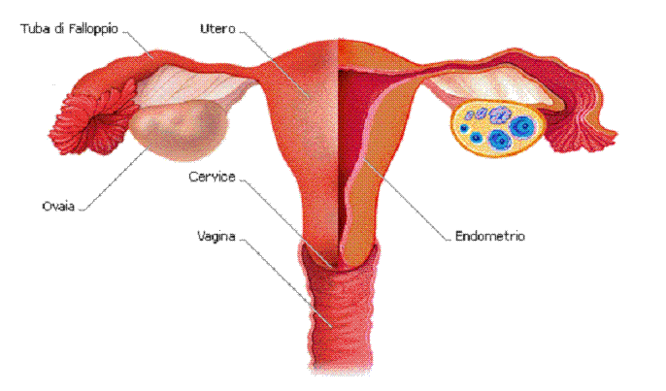

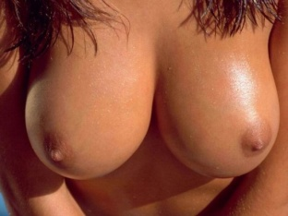
Prolactin
The effects of prolactin
Organ | the effect
Breast | Essential for lactation, breast growth
Ovaries | Participates in the regulation of the cycle
Uterus | Participates in implantation, increases progesterone receptors
Testicles | Increases sensitivity to FSH and LH
Prostate | Potentiates the action of testosterone
Pancreas | Stimulates insulin synthesis
Adipose tissue | Stimulates lipogenesis
CNS | Affects appetite, increases aggression, increases libido Inhibits the release of LH-RH, inhibits FSH, LH

Slide 9
hyperprolactinemia
Classification
1. Physiological (see above)
2. Pathological
- Hypothalamus (craniophangioma, sarcoidosis and granulomatosis)
- Pituitary gland (macro-, microadenoma, leg transection)
- Ectopic secretion (prolactin, TRH)
- primary hypothyroidism
- autoimmune diseases
- chronic renal failure
- Metabolic causes (cirrhosis, SLE)
- chest injuries, shingles

Slide 10

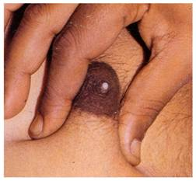

hyperprolactinemia
Main Symptoms
Galactorrhea
Swelling, enlargement of the mammary glands, colostrum secretion
2. Amenorrhea, Impotence
By suppressing FSH, LH
Main Symptoms
There are no symptoms with macrohyperprolactinemia

Slide 11
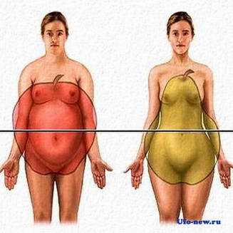
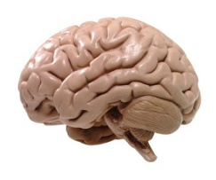

hyperprolactinemia
Clinic
Metabolic disorders (Obesity, insulin resistance, dyslipidemia)
2. Psycho-emotional disorders (asthenia, memory impairment, emotional lability, irritability, anxiety, depression)
3. Reproductive disorders (infertility in men and women, decreased sex drive, menstrual irregularities, erectile dysfunction, decreased ejaculate production)

Slide 12
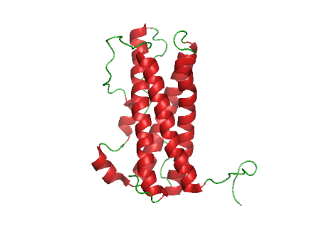
Prolactinoma
PIPITAL TUMOR SECRETING PROLACTIN
CLINIC
1. Hyperprolactinemia
2. Neurological disorders (headache, dizziness, sleep disturbance, decreased vision, loss of fields, etc.)
3. Endocrine disorders (symptoms associated with the loss of pituitary hormones)
- Hypothyroidism (decreased TSH)
- Adrenal insufficiency (ACTH)
- Diabetes insipidus (ADH)
- Hypogonadism (FSH, LH), osteoporosis

Slide 13
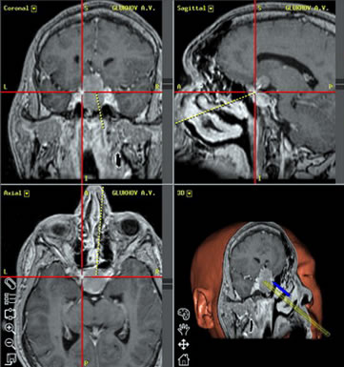
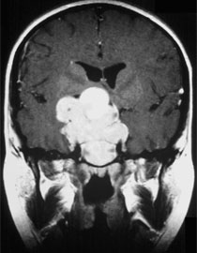
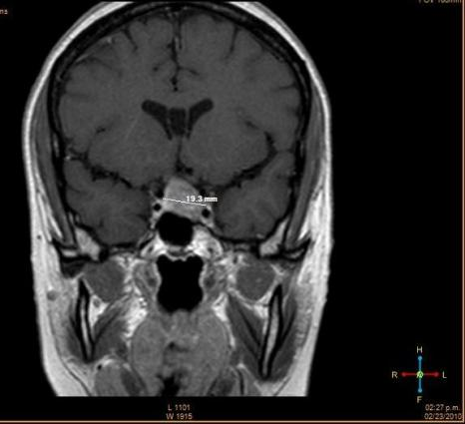
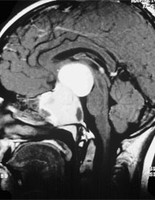
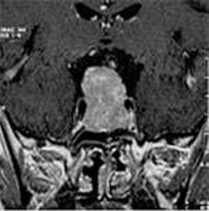
Prolactinoma
CT, MRI, X-ray
Microadenoma less than 1 cm
Macroadenoma more than 1 cm

Slide 14
Prolactinoma
Diagnostics
CLINIC
1. Prolactin (with macro more than 200 ng / l (4200 IU / l)
2. ACTH, TSH, FSH, LH, STH
3. SAMPLES
Thyreoliberin
DOP blockers. rec. 2
Increases 3 or more times
If the tumor is less than two

Slide 15
TREATMENT
1. Macroadenoma - operation
2. Auxiliary - a proton beam.
3. Medication - dopamine agonists
(I generation - proladel, bromocriptine 2.5-10 mg,
II generation - Quinagolide 75-300 mcg
III generation - Cabergoline-dostinex 0.25-4.5 per week)
Antiserotonergic - methergoline.

Slide 16

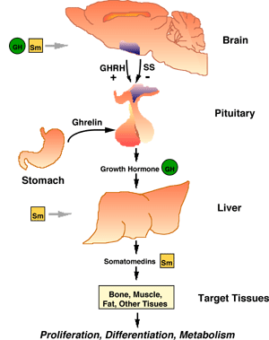
Growth hormone
The hormone of the anterior pituitary gland, peptide 191 a-k, is synthesized in the pituitary gland (It belongs to the family of polypeptide hormones, which also includes prolactin and placental lactogen )

Slide 17
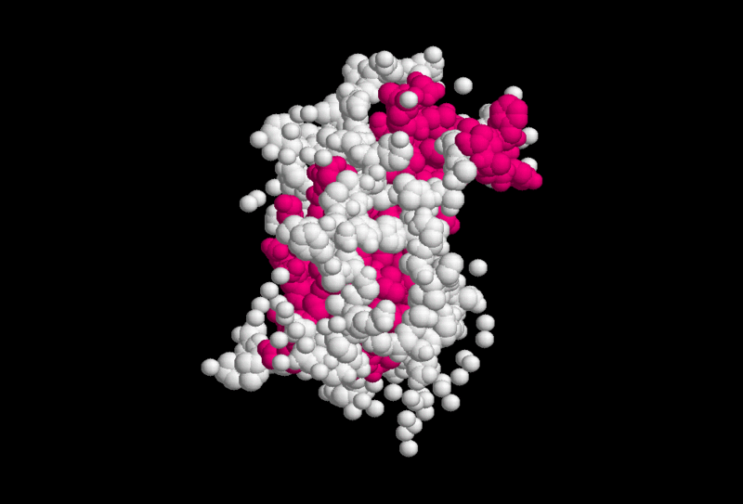
Growth hormone
Regulators + Somatoliberin
- Somatostanin
Acts through Somatomedins
(IGF1 is the main effector of STH and IGF2 plays a role in embryonic development)

Slide 18
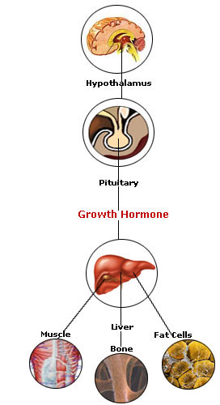
Growth hormone
Acts through Somatomedins
(IGF1 is the main effector of STH and IGF2 plays a role in embryonic development)
Effects Tissue growth

Slide 19
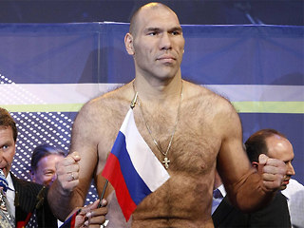

Excess STH
Usually associated with a pituitary tumor, height (age) depending on the closure of zones
Gigantism
Acromegaly
Giants - men height> 200 (205) cm
women height> 190 cm

Slide 20
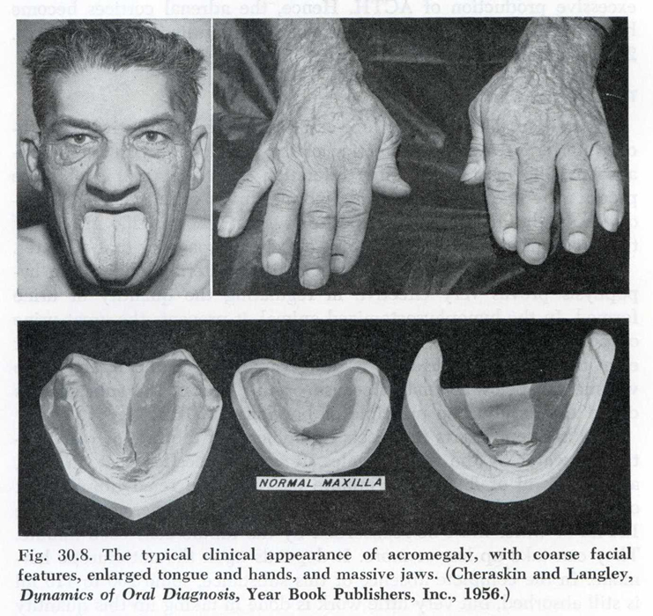
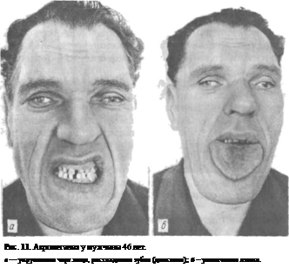

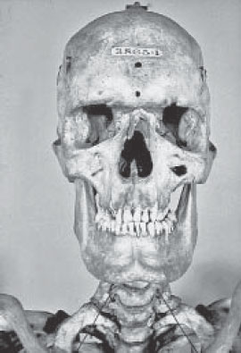
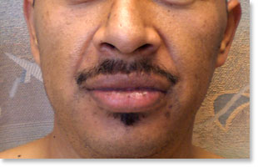
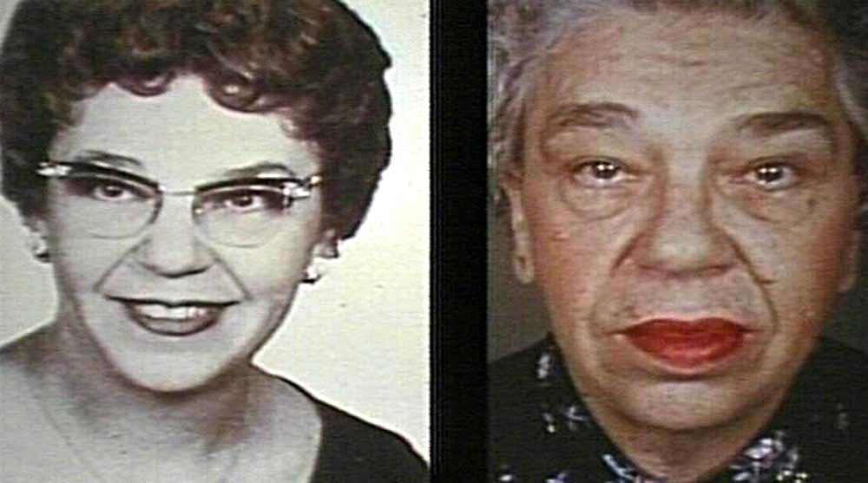
Acromegaly
clinic
Coarsening of facial features superciliary arches, nose, ears, cheekbones, jaw, interdental spaces

Slide 21
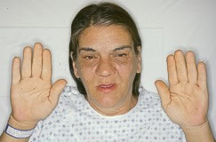
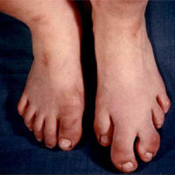

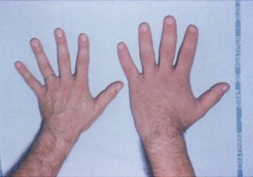
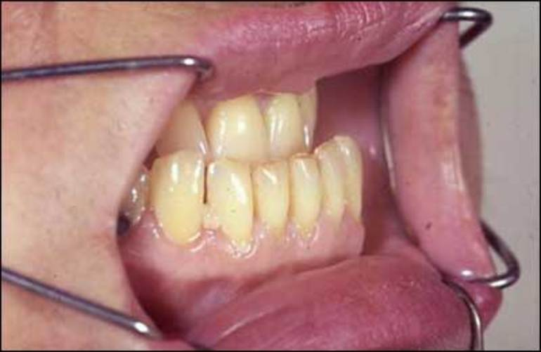
Disproportionate increase in hands and feet

Slide 22
Acromegaly
clinic
Symptom | Cause
Excessive sweating | increased sweat glands and increased metabolism
Carpal tunnel syndrome | compression of the median nerve with hypertrophied tissue of the wrist joint
Deforming arthrosis | especially pronounced in large joints, develops secondarily due to tissue overgrowth and joint deformation (weight)
Arterial hypertension | myocardial hypertrophy, salt retention
Diabetes | STH counterinsular hormone
Hypercalciuria, kidney stones | STH stimulates the production of Vit D
Visceromegaly | STH stimulation (AH then HF)
Weight gain | Anabolic effect

Slide 23
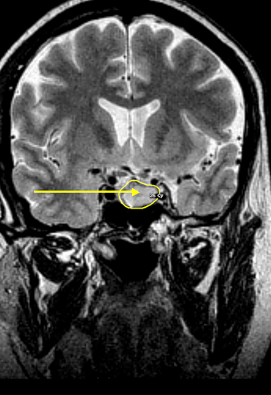
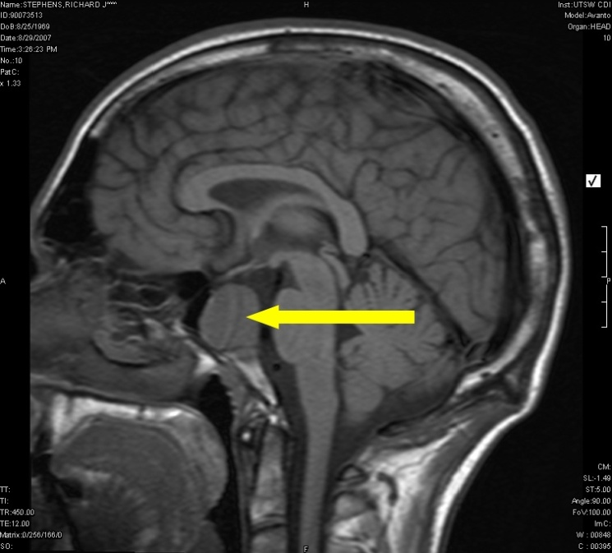
Acromegaly
Symptoms of tumor progression:
1) Headaches;
2) Visual impairment;
3) An increase in the size of the Turkish saddle.
.

Slide 24
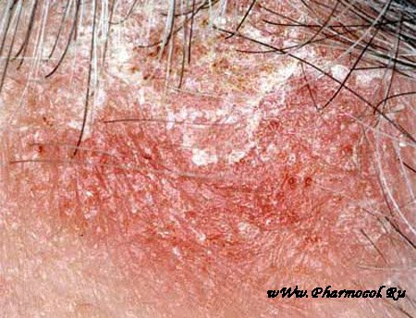
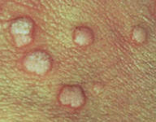

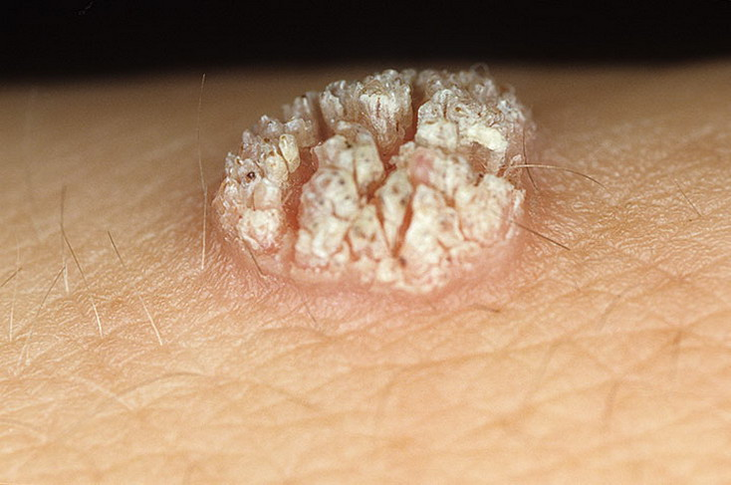
The main clinical symptoms and complications of acromegaly from the skin
Acantosis nigricans
Rough skin folds
Aspe
Hirsutism
Profuse sweating
Seborrhea
Warts
hydradenitis

Slide 25
Acromegaly
1) The level of growth hormone in blood plasma is above 10 pg / ml (> 250 pmol / l), the norm is 2-5 pg / ml (46-230 pmol / l).
2) In cases where the level of growth hormone is 5-10 ng / ml (230-250 pmol / l), a glucose load test is performed. Normally, an increase in plasma glucose inhibits the secretion of growth hormone and its concentration in the blood decreases to 2 ng / ml (93 pmol / l) and less after 45-60 minutes. With acromegaly, the concentration of growth hormone remains at the initial level and often increases. This is due to the autonomy of growth hormone secretion by the adenoma.
3) The rhythm of growth hormone secretion. Normally, the highest peak of growth hormone secretion is at night. In acromegaly, there is no nightly peak in secretion.
.

Slide 26
Diagnostics
4) Study of the concentration of IGF-1 in blood plasma. In all patients with acromegaly, the level of IGF-1 in the blood is higher than normal, which indicates an excess of growth hormone.
5) Test with bromocriptine. Bromocriptine, being a dopamine agonist, normally increases the secretion of growth hormone. In patients with acromegaly, bromocriptine paradoxically suppresses GH secretion.
6) In many patients with acromegaly, glucose tolerance may be impaired. Diabetes mellitus may be much less common. Diabetes is a consequence of insulin resistance caused by excess growth hormone.

Slide 27
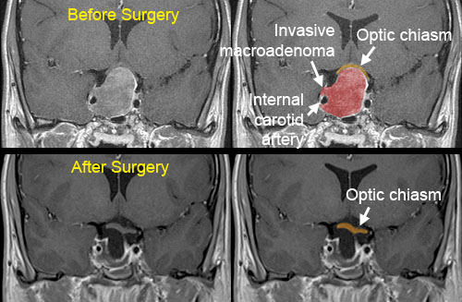
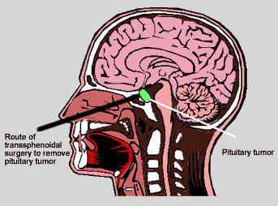
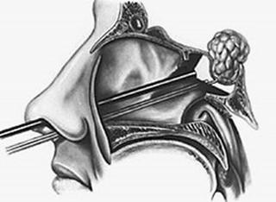
Acromegaly
Treatment - operative

Slide 28
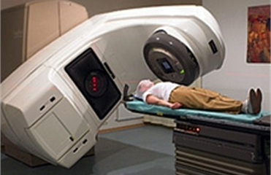
Acromegaly
Treatment - conservative
Telegammotherapy in a total dose of 4500-5000 Rad is successful in 60-80% of patients. However, the effect occurs slowly over 2-5 years.
Proton beam (irradiation by heavy particles) to the pituitary gland. In these cases, the normalization of the level of growth hormone in the blood serum <5 ng / ml occurs faster than with telegammotherapy.
Treatment by implantation of radioactive gold into the tumor is effective in 70% of patients, but it is carried out only in certain centers.

Slide 29
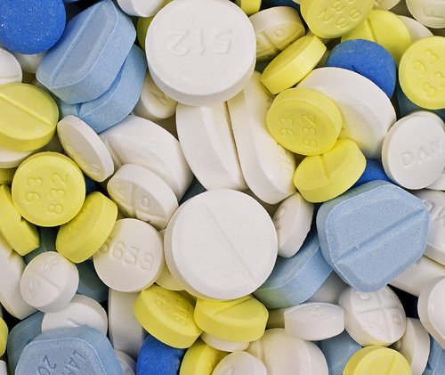
Acromegaly
Treatment - conservative
Somatostatin - 14-amino acid cyclic peptide: reduces GH
Sandostatin - LAR - 30 mg intramuscularly 1 time in 2-3 weeks
Lanreotide (somatulin) - 10-30 mg intramuscularly 1 time in 28 days - the effectiveness of reducing STH and IRF-1 65-70%; in 20-50%, a decrease in the volume of adenoma is more than 45% of the original .

Slide 30

Thanks for attention

